Slide 1
COMP9414 Tutorial
Week 5

Slide 2

News
Assignment 1 is due this week (Friday, 3rd July)
Wayne will do one final consultation session on it
Make sure you’re printing to standard output so that piping will work (program > output1.txt)
Assignment 2 will be released next week
Will only know how to complete it after the week 7 lecture
Not expected to start it
Week 6 will be a week break for us
Consultations only

Slide 3
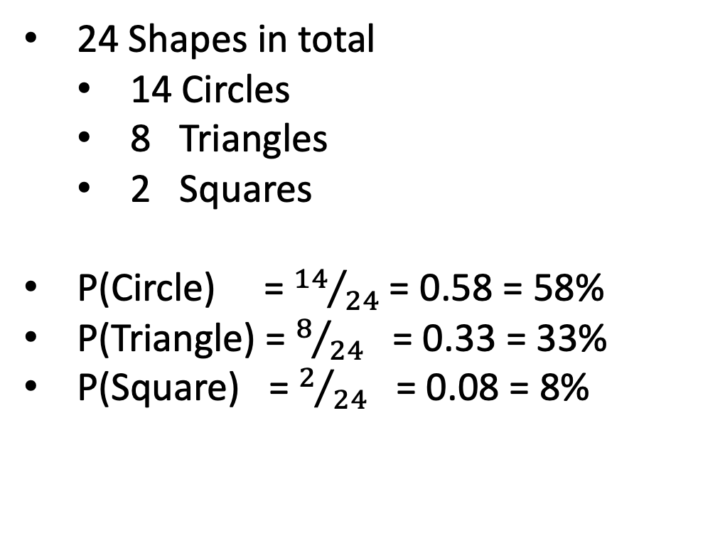
Background – Base Example
24 Shapes in total
14 Circles
8 Triangles
2 Squares
P(Circle) = ${14}/{24}$= 0.58 = 58%
P(Triangle) = $8/{24}$ = 0.33 = 33%
P(Square) = $2/{24}$ = 0.08 = 8%

Slide 4
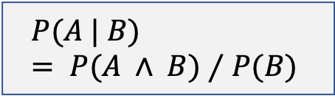
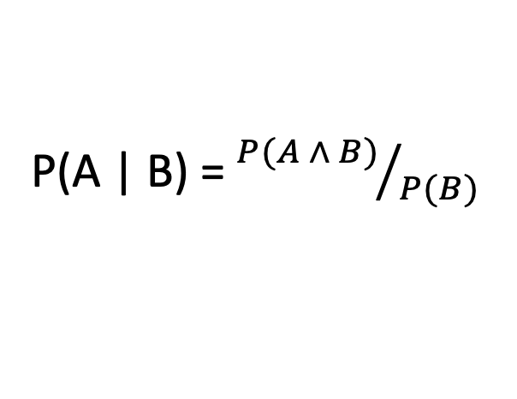
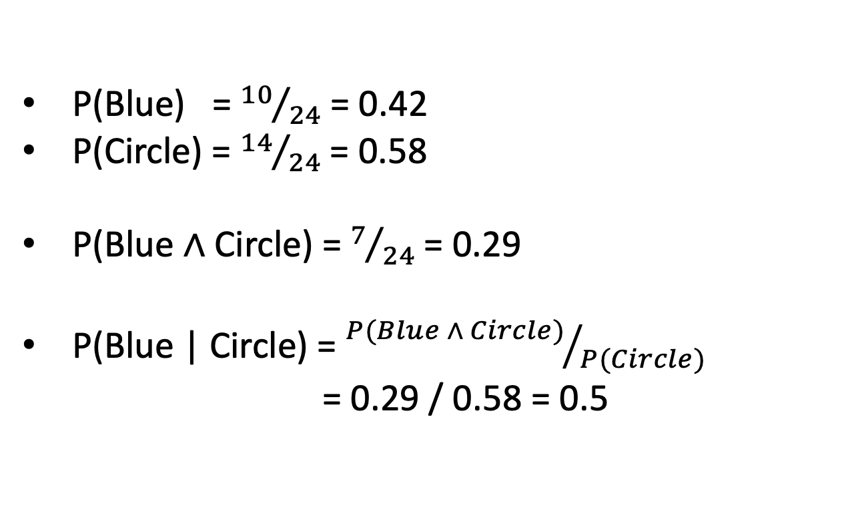
Background – Conditional Probability
$$P(A | B) = P(A ∧ B)⁄P(B)$$
Given a circle, what is the probability that it is blue:
P(Blue | Circle)
P(Blue) = ${10}/{24}$= 0.42
P(Circle) = ${14}/{24}$= 0.58
P(Blue ∧ Circle) = $7/{24}$= 0.29
P(Blue | Circle) = ${P(Blue ∧ Circle)}/{P(Circle)}$
= 0.29 / 0.58 = 0.5
P(A | B) = ${P(A ∧ B)}/{P(B)}$

Slide 5
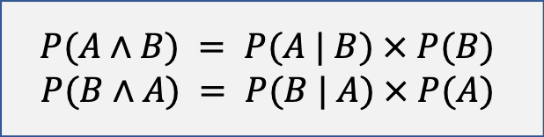

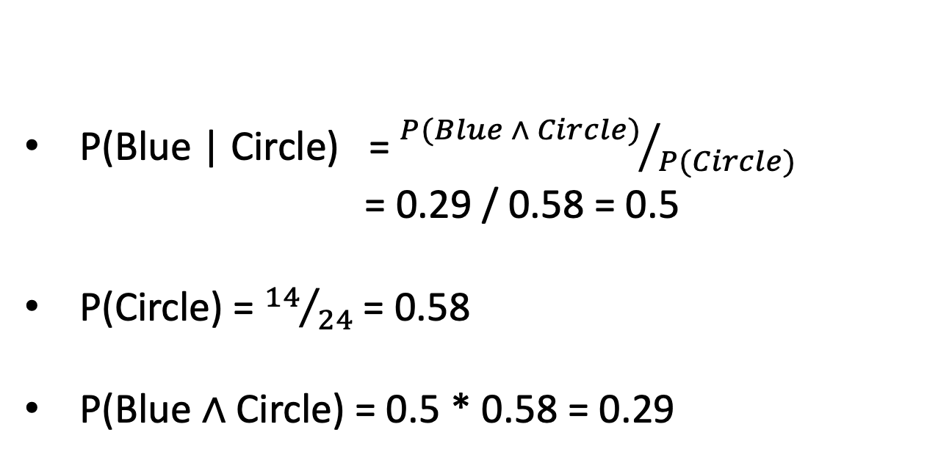
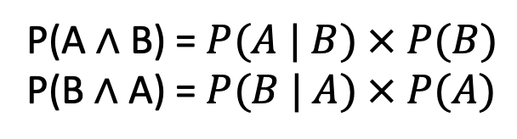
Background – Product Rule
$$P(A∧B) = P(A | B) × P(B)$$
$$P(B∧A) = P(B | A) × P(A)$$
What is the probability of a shape being blue and a circle:
P(Blue $∧$ Circle)
P(Blue | Circle) = ${P(Blue ∧ Circle)}/{P(Circle)}$
= 0.29 / 0.58 = 0.5
P(Circle) = ${14}/{24}$= 0.58
P(Blue $∧$ Circle) = 0.5 * 0.58 = 0.29
P(A $∧$ B) = $P(A | B) × P(B)$
P(B $∧$ A) = $P(B | A) × P(A)$

Slide 6
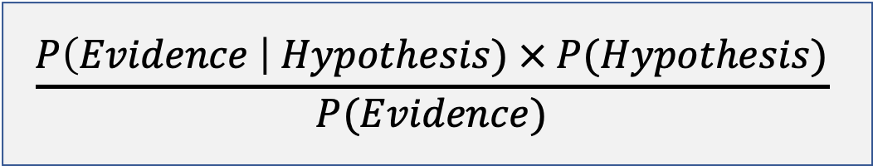
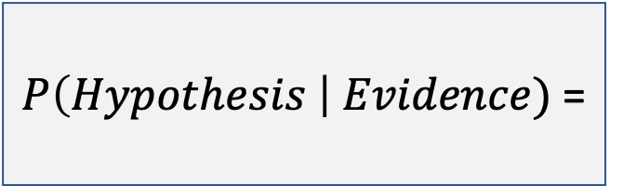
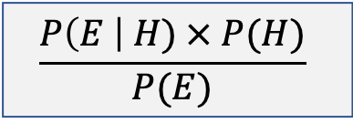

Bayes Theorem
$P\left(H \right| E)$ =
$$\frac{P\left(E \right| H) × P(H)}{P(E)}$$
Probability of a given event occurring based on our prior knowledge or evidence
$P\left(Hypothesis \right| Evidence)$ =
$$\frac{P\left(Evidence \right| Hypothesis) × P(Hypothesis)}{P(Evidence)}$$

Slide 7

Bayes Theorem - Walkthrough
Evaluate a probability based on evidence that may increase or decrease it whilst being known.
Low chance of a general fire
P(Fire) = 0.01 = 1%
Will this change given that we see smoke however?
Fire

Slide 8

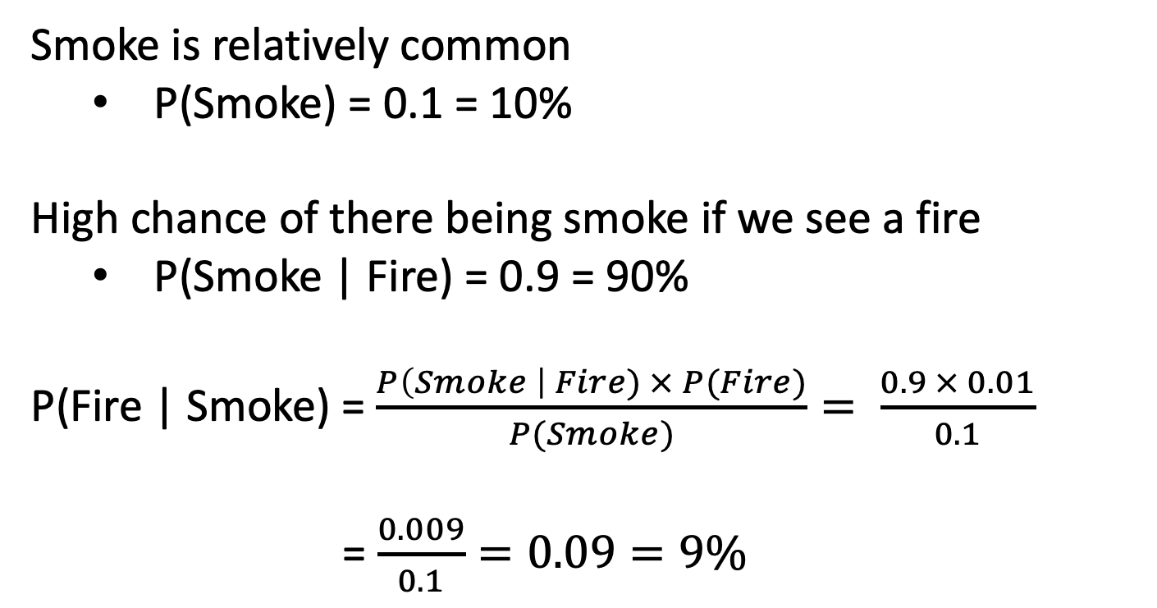
Bayes Theorem - Walkthrough
Smoke is relatively common
P(Smoke) = 0.1 = 10%
High chance of there being smoke if we see a fire
P(Smoke | Fire) = 0.9 = 90%
P(Fire | Smoke) = $\frac{P\left(Smoke \right| Fire) × P(Fire)}{P(Smoke)}= \frac{0.9 × 0.01}{0.1}$
= $\frac{0.009}{0.1}=0.09=9\%$
Fire + Smoke

Slide 9
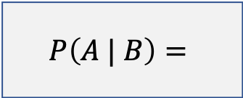

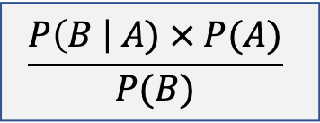
Question 1 - Proof
$$P(A∧B) = P(A | B) × P(B)$$
$$P(B∧A) = P(B | A) × P(A)$$
$$P(A ∧ B)= P(A│B) × P(B)$$
Show how to derive Bayes’ Rule from the definition:
$$P\left(A | B\right)=$$
$$\frac{P\left(B \right| A) × P(A)}{P(B)}$$

Slide 10
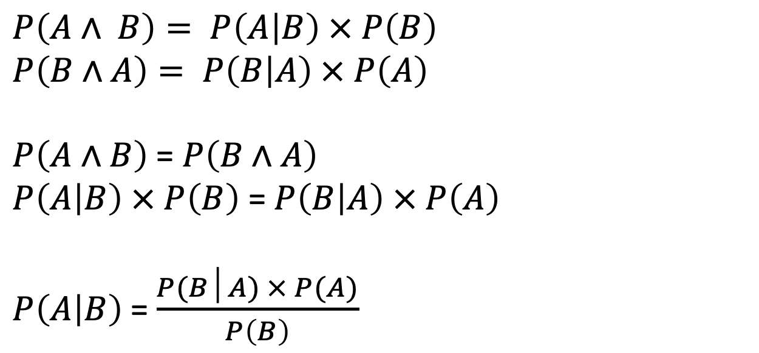
Question 1 - Proof
$$P(A∧B) = P(A | B) × P(B)$$
$$P(B∧A) = P(B | A) × P(A)$$
$$P(A ∧ B)= P(A│B) × P(B)$$
Show how to derive Bayes’ Rule from the definition:
$$P\left(A∧ B\right)= P\left(A | B\right) × P\left(B\right)$$
$$P\left(B∧A\right)= P\left(B | A\right) × P\left(A\right)$$
$P\left(A∧B\right)$ = $P\left(B∧A\right)$
$P\left(A | B\right) × P\left(B\right)$ = $P\left(B | A\right) × P\left(A\right)$
$P\left(A | B\right)$= $\frac{P(B│A) × P(A)}{P\left(B\right)}$
$$P\left(A | B\right)=$$
$$\frac{P\left(B \right| A) × P(A)}{P(B)}$$

Slide 11
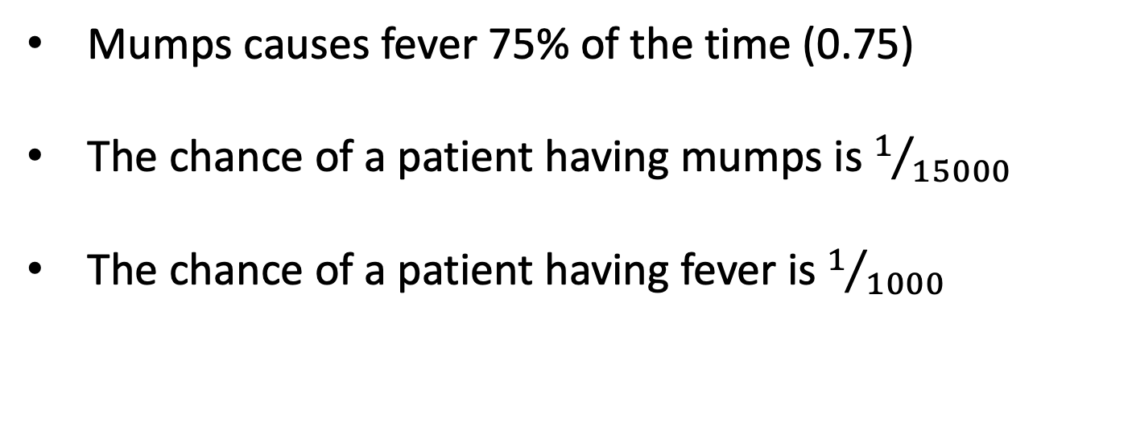

Question 2 – Conditional Probability
Determine the conditional probability of a patient suffering from mumps given that they have don’t have a fever:
$$P\left(Mumps \right| ¬Fever)$$
Mumps causes fever 75% of the time (0.75)
The chance of a patient having mumps is $1/{15000}$
The chance of a patient having fever is $1/{1000}$

Slide 12




Question 2 – Conditional Probability
$$P\left(Mumps \right| ¬Fever)$$
$$P\left(Mumps\right)=0.000066$$
$$P(Fever)=0.001$$
$$P\left(Fever \right| Mumps)=0.75$$

Slide 13
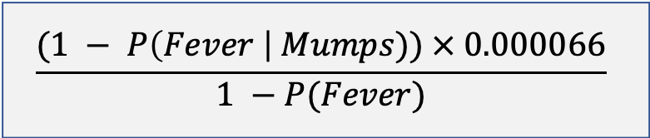
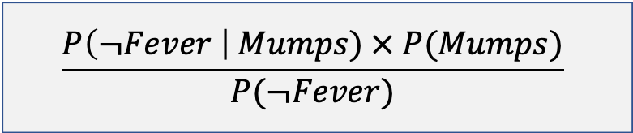
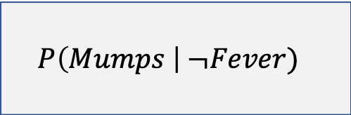


Question 2 – Conditional Probability
$$P\left(Mumps \right| ¬Fever)$$
$$P\left(Mumps\right)=0.000066$$
$$P(Fever)=0.001$$
$$P\left(Fever \right| Mumps)=0.75$$
$$P\left(Mumps \right| ¬Fever)$$
$$\frac{P\left(¬Fever \right| Mumps) × P(Mumps)}{P(¬Fever)}$$
$$\frac{(1 − P\left(Fever \right| Mumps)) × 0.000066}{1 −P(Fever)}$$
$$\frac{0.25 × 0.000066}{0.999}$$
$$0.0000165$$

Slide 14










Question 3i
Headaches and blurred vision may be the result of sitting too close to a monitor. Headaches may also be caused by bad posture. Headaches and blurred vision may cause nausea. Headaches may also lead to blurred vision.
H
Headache
B
Blurred Vision
S
Sitting to close to a monitor
P
Bad posture
N
Nausea

Slide 15
Question 3i
Headaches and blurred vision may be the result of sitting too close to a monitor. Headaches may also be caused by bad posture. Headaches and blurred vision may cause nausea. Headaches may also lead to blurred vision.
H
Headache
P
S
B
Blurred Vision
S
Sitting to close to a monitor
H
B
P
Bad posture
N
Nausea
N

Slide 16


Question 3i
$$P\left(H∧B∧S∧P∧N\right)=$$
P
S
H
B
N

Slide 17





Question 3i
$$P\left(H∧B∧S∧P∧N\right)=$$
P
S
$$P(H|P∧S)$$
$$P(B|S∧H)$$
$$P(S)$$
H
B
$$P(P)$$
$$P(N|H∧B)$$
N
$$P\left(H∧B∧S∧P∧N\right)=P\left(H | P∧S\right) × P\left(B | S∧H\right) × P\left(S\right) × P\left(P\right) × P(N|H∧B)$$

Slide 18
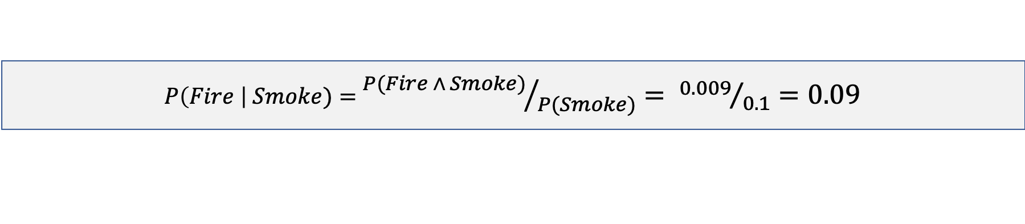
Background – Joint Probabilities
Enumerate through all possible probabilities based on the value distribution of the variables involved.
 | Smoke | ¬Smoke | Total
Fire | 0.009 | 0.001 | 0.01
¬Fire | 0.01 | 0.899 | 0.99
Total | 0.1 | 0.9 | 1.0
$P\left(Fire \right| Smoke)=$ ${P(Fire ∧ Smoke)}/{P(Smoke)}= {0.009}/{0.1}=0.09$

Slide 19














Question 3ii
$$P\left(H | P∧S\right)=0.8$$
$$P\left(H | P∧¬S\right)=0.4$$
P
S
$$P\left(H | ¬P∧S\right)=0.6$$
$$P\left(H | ¬P∧¬S\right)=0.02$$
H
B
$$P\left(B | S∧H\right)=0.4$$
$$P\left(B | S∧¬H\right)=0.2$$
N
$$P\left(B | ¬S∧H\right)=0.3$$
$$P\left(B | ¬S∧¬H\right)=0.01$$
$$P\left(N | H∧B\right)=0.9$$
$$P\left(N | H∧¬B\right)=0.5$$
$$P(S)=0.1$$
$$P\left(N | ¬H∧B\right)=0.3$$
$$P\left(N | ¬H∧¬B\right)=0.7$$
$$P(P)=0.2$$

Slide 20










Question 3ii
$$P\left(H\right)=True$$
$$P\left(N\right)=False$$
P
P
S
S
H
H
B
B
$$P\left(H∧¬N∧B∧S∧P\right)$$
$$P\left(H∧¬N∧¬B∧¬S∧P\right)$$
N
N
$$P\left(H∧¬N∧¬B∧S∧P\right)$$
$$P\left(H∧¬N∧¬B∧S∧¬P\right)$$
$$P\left(H∧¬N∧B∧¬S∧P\right)$$
$$P\left(H∧¬N∧B∧¬S∧¬P\right)$$
$$P\left(H∧¬N∧B∧S∧¬P\right)$$
$$P\left(H∧¬N∧¬B∧¬S∧¬P\right)$$

Slide 21






Question 3ii
$$P\left(H\right)=True$$
$$P\left(N\right)=False$$
P
S
$$P\left(H∧¬N∧B∧S∧P\right)$$
H
B
$$P\left(H | P,S\right)=0.8$$
$$P\left(S\right)=0.1$$
N
$$P\left(¬N | H,B\right)=0.1$$
$$P\left(P\right)=0.2$$
$$P\left(B | S,H\right)=0.4$$

Slide 22




Question 3ii
$$P\left(H\right)=True$$
$$P\left(N\right)=False$$
P
S
$$P\left(H∧¬N∧B∧S∧P\right)$$
H
B
$$P\left(H | P,S\right)=0.8$$
$$P\left(S\right)=0.1$$
N
$$P\left(¬N | H,B\right)=0.1$$
$$P\left(P\right)=0.2$$
$$P\left(B | S,H\right)=0.4$$
$$P\left(H∧¬N∧B∧S∧P\right)=P\left(H | P,S\right) × P\left(¬N | H,B\right) × P\left(B | S,H\right) × P\left(S\right) × P\left(P\right)$$
$$P\left(H∧¬N∧B∧S∧P\right)=0.8 × 0.1 × 0.4 × 0.1 × 0.2$$
$$0.00064$$

Slide 23






Question 3ii
$$P\left(H\right)=True$$
$$P\left(N\right)=False$$
P
S
$$P\left(H∧¬N∧¬B∧¬S∧¬P\right)$$
H
B
$$P\left(H | ¬P,¬S\right)=0.02$$
$$P\left(¬S\right)=0.9$$
N
$$P\left(¬N | H,¬B\right)=0.5$$
$$P\left(¬P\right)=0.8$$
$$P\left(¬B | ¬S,H\right)=0.7$$

Slide 24


Question 3ii
$$P\left(H\right)=True$$
$$P\left(N\right)=False$$
P
S
$$P\left(H∧¬N∧¬B∧¬S∧¬P\right)$$
H
B
$$P\left(H | ¬P,¬S\right)=0.02$$
$$P\left(¬S\right)=0.9$$
N
$$P\left(¬N | H,¬B\right)=0.5$$
$$P\left(¬P\right)=0.8$$
$$P\left(¬B | ¬S,H\right)=0.7$$
$$P\left(H∧¬N∧¬B∧¬S∧¬P\right)=P\left(H | ¬P,¬S\right) × P\left(¬N | H,¬B\right) × P\left(¬B | ¬S,H\right) × P\left(¬S\right) × P\left(¬P\right)$$
$$P\left(H∧¬N∧B∧S∧P\right)=0.02 × 0.5 × 0.7 × 0.9 × 0.8$$
$$0.00504$$

Slide 25
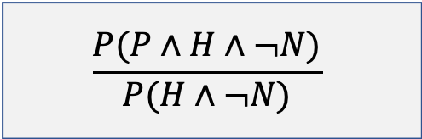

Question 3iii
What is the probability that the patient suffers from bad posture given that they are suffering from headaches but not from nausea?
Product Rule
$$P\left(P \right| H∧¬N)$$
$$\frac{P(P∧H∧¬N)}{P(H∧¬N)}$$

Slide 26










Question 3iii
$$\frac{P(P∧H∧¬N)}{P(H∧¬N)}$$
What is the probability that the patient suffers from bad posture given that they are suffering from headaches but not from nausea?
$$P\left(P \right| H∧¬N)$$
$$P\left(H∧¬N∧B∧S∧P\right)=0.00064$$
$$P\left(H∧¬N∧¬B∧¬S∧P\right)=0.02520$$
$$P\left(H∧¬N∧¬B∧S∧P\right)=0.00480$$
$$P\left(H∧¬N∧¬B∧S∧¬P\right)=0.0144$$
$$P\left(H∧¬N∧B∧¬S∧P\right)=0.00216$$
$$P\left(H∧¬N∧B∧¬S∧¬P\right)=0.000432$$
$$P\left(H∧¬N∧B∧S∧¬P\right)=0.00192$$
$$P\left(H∧¬N∧¬B∧¬S∧¬P\right)=0.00504$$

Slide 27


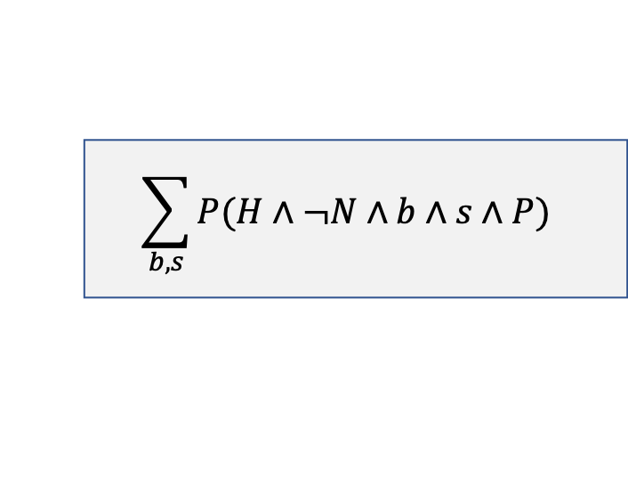





Question 3iii
$$P(P∧H∧¬N)$$
$$\sum_{b, s}{P(H∧¬N∧b∧s∧P) }$$
$$P\left(H∧¬N∧B∧S∧P\right)=0.00064$$
$$P\left(H∧¬N∧¬B∧¬S∧P\right)=0.02520$$
$$0.00064+0.02520+0.00480+0.00216$$
$$P\left(H∧¬N∧¬B∧S∧P\right)=0.00480$$
$$0.0328$$
$$P\left(H∧¬N∧B∧¬S∧P\right)=0.00216$$

Slide 28




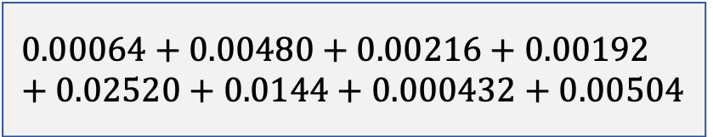







Question 3iii
$$P(H∧¬N)$$
$$\sum_{b, s,p}{P(H∧¬N∧b∧s∧p) }$$
$$P\left(H∧¬N∧B∧S∧P\right)=0.00064$$
$$P\left(H∧¬N∧¬B∧S∧P\right)=0.00480$$
$$P\left(H∧¬N∧B∧¬S∧P\right)=0.00216$$
$$P\left(H∧¬N∧B∧S∧¬P\right)=0.00192$$
$$P\left(H∧¬N∧¬B∧¬S∧P\right)=0.02520$$
$$P\left(H∧¬N∧¬B∧S∧¬P\right)=0.0144$$
$$P\left(H∧¬N∧B∧¬S∧¬P\right)=0.000432$$
$$P\left(H∧¬N∧¬B∧¬S∧¬P\right)=0.00504$$
$$0.00064+0.00480+0.00216+0.00192+0.02520+0.0144+0.000432+0.00504$$
$$0.054592$$

Slide 29
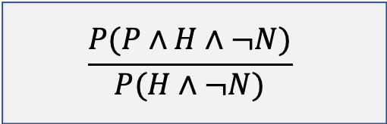

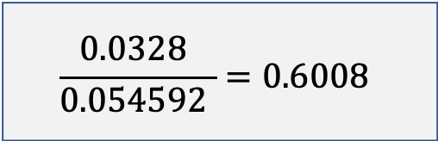
Question 3iii
$$\frac{P(P∧H∧¬N)}{P(H∧¬N)}$$
$P\left(P \right| H∧¬N)$ =
$$\frac{P(P∧H∧¬N)}{P(H∧¬N)}$$
$$\frac{0.0328 }{0.054592 }=0.6008$$

Slide 30


Background – Chain Rule
$$P\left(A∧B\right)=P\left(B \right| A) × P(A)$$
The probability of observing two events $A$ and $B$ is equivalent to the probability of observing $A$ multiplied by the probability of observing $B$ given $A$
$$P\left(A∧B∧C∧D\right)=P\left(A \right| B,C,D)$$
$$P\left(A∧B∧C∧D\right)=P\left(A \right| B,C,D) × P\left(B \right| C,D)$$
$$P\left(A∧B∧C∧D\right)=P\left(A \right| B,C,D) × P\left(B \right| C,D) × P\left(C \right| D)$$
$$P\left(A∧B∧C∧D\right)=P\left(A \right| B,C,D) × P\left(B \right| C,D) × P\left(C \right| D) × P(D)$$

Slide 31





Question 4
Burglary
Earthquake
Alarm
JohnCalls
MaryCalls

Slide 32









Question 4
$$P\left(Burglary\right)=0.001$$
Burglary
Earthquake
$$P\left(Earthquake\right)=0.002$$
Alarm
$$P\left(Alarm | Burglary∧Earthquake\right)=0.95$$
JohnCalls
MaryCalls
$$P\left(Alarm |Burglary∧¬Earthquake\right)=0.94$$
$$P\left(Alarm |¬Burglary∧Earthquake\right)=0.29$$
$$P\left(MaryCalls | Alarm\right)=0.70$$
$$P\left(Alarm |¬Burglary∧¬Earthquake\right)=0.001$$
$$P\left(MaryCalls |¬Alarm\right)=0.01$$
$$P\left(JohnCalls | Alarm\right)=0.90$$
$$P\left(JohnCalls |¬Alarm\right)=0.05$$

Slide 33




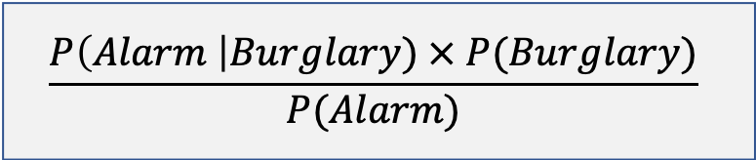








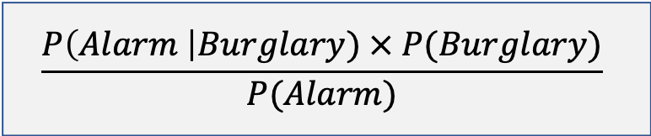


Question 4
$$\frac{P\left(Alarm \right|Burglary) × P(Burglary)}{P(Alarm)}$$
$$P\left(Burglary \right| Alarm)=$$
$$\frac{P\left(Alarm \right|Burglary) × P(Burglary)}{P(Alarm)}$$
Burglary
Earthquake
Alarm
JohnCalls
MaryCalls
$$P\left(Alarm \right| Burglary)$$
$$P(Burglary)$$
$$P\left(Alarm \right| Burglary∧Earthquake) × P(Earthquake)$$
$0.95 ×$ 0.002 $×$0.001
$$0.0000019$$
$$P\left(Alarm \right| Burglary∧¬Earthquake) × P(¬Earthquake)$$
$0.94 ×$ 0.998 $×$0.001
$$0.0009381$$
$0.0000019+0.0009381$ = 0.00094

Slide 34

Question 4
$$\frac{P\left(Alarm \right|Burglary) × P(Burglary)}{P(Alarm)}$$
$$P\left(Burglary \right| Alarm)=$$
$$\frac{P\left(Alarm \right|Burglary) × P(Burglary)}{P(Alarm)}$$
Burglary
Earthquake
Alarm
JohnCalls
MaryCalls
$$P(Alarm)$$
$$P\left(Alarm \right| Burglary∧Earthquake) × P(Burglary)× P(Earthquake)$$
$$P\left(Alarm \right| Burglary∧¬Earthquake)× P(Burglary)× P(¬Earthquake)$$
$$P\left(Alarm \right|¬Burglary∧Earthquake)× P(¬Burglary)× P(Earthquake)$$
$$P\left(Alarm \right|¬Burglary∧¬Earthquake)× P(¬Burglary)× P(¬Earthquake)$$

Slide 35








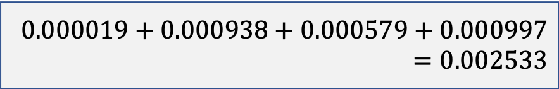
Question 4
$$\frac{P\left(Alarm \right|Burglary) × P(Burglary)}{P(Alarm)}$$
$$P\left(Burglary \right| Alarm)=$$
$$\frac{P\left(Alarm \right|Burglary) × P(Burglary)}{P(Alarm)}$$
Burglary
Earthquake
Alarm
JohnCalls
MaryCalls
$$P(Alarm)$$
$$0.000019+0.000938+0.000579+0.000997=0.002533$$
$0.95 ×$ 0.02 $×$0.001
$$0.000019$$
$0.94 ×$ 0.998 $×$0.001
$$0.000938$$
$0.29 ×$ 0.999 $×$0.002
$$0.000579$$
$0.001 ×$ 0.998 $×$0.999
$$0.000997$$

Slide 36









Question 4
$$\frac{P\left(Alarm \right|Burglary) × P(Burglary)}{P(Alarm)}$$
$$P\left(Burglary \right| Alarm)=$$
$$\frac{P\left(Alarm \right|Burglary) × P(Burglary)}{P(Alarm)}$$
Burglary
Earthquake
Alarm
$$\frac{\text{0.00094}}{0.002533 }=0.3711$$
JohnCalls
MaryCalls

Slide 37
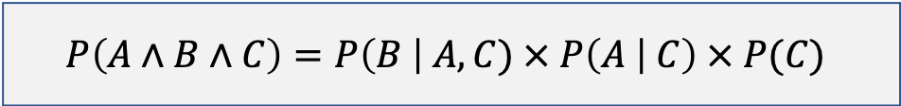
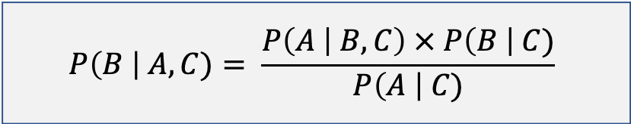
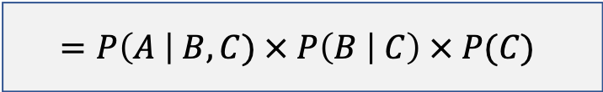

Question 5 - Proof
$$P\left(B \right| A,C)= \frac{P\left(A | B,C\right) × P\left(B \right| C)}{P\left(A \right| C)}$$
$$Chain Rule$$
$$P\left(A∧B∧C\right)=P\left(B \right| A,C) × P\left(A | C\right) × P(C)$$
Both are equivalent
$$=P\left(A \right| B,C) × P\left(B | C\right) × P(C)$$

Slide 38
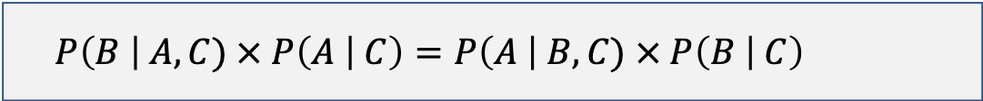
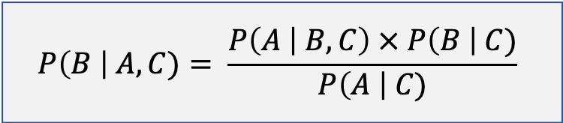
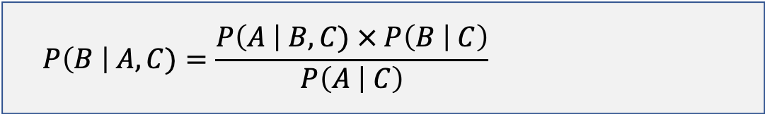
Question 5 - Proof
$$P\left(B \right| A,C)= \frac{P\left(A | B,C\right) × P\left(B \right| C)}{P\left(A \right| C)}$$
$$P\left(B \right| A,C) × P\left(A | C\right) × P\left(C\right)=P\left(A \right| B,C) × P\left(B | C\right) × P(C)$$
$$P\left(B \right| A,C) × P\left(A | C\right)=P\left(A \right| B,C) × P\left(B | C\right)$$
$$P\left(B \right| A,C)=\frac{P\left(A \right| B,C) × P\left(B | C\right)}{P\left(A | C\right)}$$

Slide 39
Notes
All python files for the assignment can be found at:
https://artint.info/AIPython/
Some nice videos on Bayes Theorem:
https://www.youtube.com/watch?v=OqmJhPQYRc8
https://www.youtube.com/watch?v=HZGCoVF3YvM
https://www.youtube.com/watch?v=U_85TaXbeIo

